Slide 1
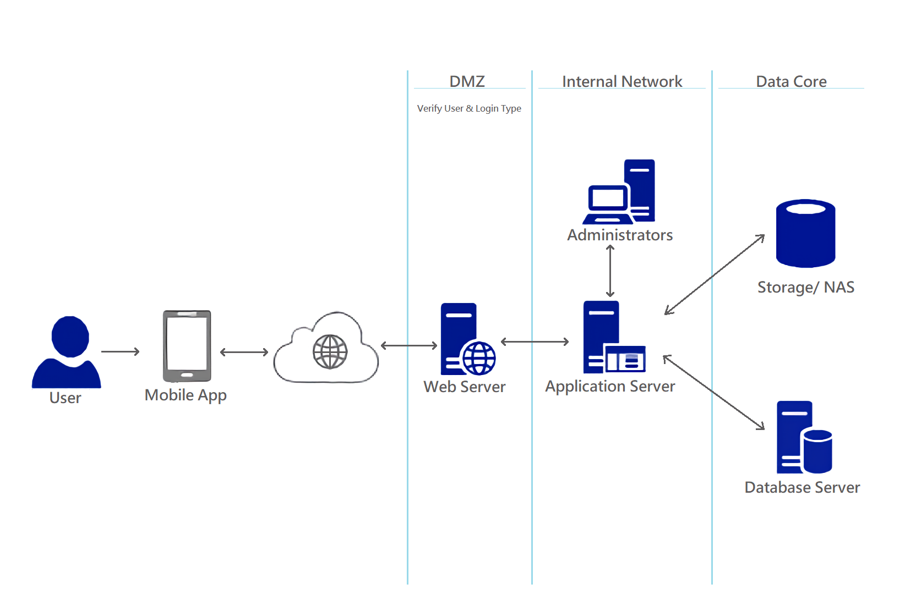
Application: Hungry Alarm
Type: Application Architecture
View: Process View
Style: Client-Server Architecture Pattern

Slide 2

Application: Hungry Alarm
Type: Application Architecture
View: Logical View
Style: Layered Architecture Pattern
Users
Delivery Channels
Core Business Processes
Data and Information
Technology Enablers
Account Management
User Data
Email
E-Payment
Event Searching
Event Data
Customers
Mobile App
Message Bus
Event Posting
Reservation Data
Real-time Bus
Restaurants
Reservation Management
Filtering Data
B2B-getaway
Help Desk
Payment Information
Positioning Service

